Slide 1

Cloud-Enabled IoT Based Home Incubation System
Borra Umesh Chandra (RA2011044010014)
Guide - Dr.Vinoth Kumar B Sir

Slide 2
ABSTRACT
The proposed egg incubator system integrates Arduino microcontrollers and NodeMCU for IoT capabilities to optimize egg development and hatch rates. Through real-time monitoring and control facilitated by NodeMCU, the system ensures the ideal conditions of temperature, humidity, and egg rotation for successful incubation. The incorporation of an egg rotator further enhances the incubation process by evenly distributing temperature across all sides of the egg, maximizing hatch rates and producing healthier chicks. This innovation addresses critical concerns in the agriculture sector by providing a reliable and efficient solution for egg incubation, ultimately leading to improved productivity. Additionally, the proposal for a low-cost neonatal baby incubator with real-time monitoring capabilities leverages microcontrollers and IoT technology to maintain optimal conditions for infant care. Through real-time monitoring of temperature, humidity, and motion detection, the incubator ensures the well-being of newborns, particularly in resource-constrained settings where access to traditional healthcare facilities may be limited. This initiative holds significant promise for improving survival rates among infants and addressing key challenges in the healthcare sector, thereby contributing to better outcomes for neonatal care.

Slide 3
INTRODUCTION
Efficient egg incubation is crucial for poultry production, requiring precise control of temperature and humidity. Traditional methods face challenges in maintaining optimal conditions, impacting hatch rates and chick survival. Our project introduces an IoT-based egg incubator system aimed at improving hatching success rates by enabling remote monitoring of temperature and humidity through a dedicated website. Upon egg hatching, detection occurs on the website, facilitating timely chick retrieval and reducing chick mortality.
Key Features:
Remote monitoring of temperature and humidity via dedicated website
Real-time detection of egg hatching for timely chick retrieval
Enhanced hatching success rates and reduced chick mortality
Equal distribution of temperature on all sides of the egg through egg rotates

Slide 4
LITERATURE REVIEW
Sno. | Title | Author | Year | Content
1. | Design and Development of an Efficient IoT-based Egg Incubation System | •Pappuraj Bhottacharjee •Abu Saeid •Md. Obaidur Rahman •Md. Golam Mostofa •Khawja Imran Masud | 2023 | Egg incubation system aimed at addressing challenges in large-scale egg hatching for the poultry industry. The proposed system monitors critical factors such as environmental humidity and temperature remotely via an Android application, SMS alerts through GSM modules, and real-time camera snapshots. But this system doesn’t have cloud system to store data of each and every day automatically .

Slide 5
Sno. | Title | Author | Year | Content
2. | REMOTE INTELLIGENT INFANT INCUBATOR | •Daram Anitha Kumari •Renuka Thotakura •Naveen Balaji Kommina | 2019 | A practical and low-cost solution for real-time monitoring of newborns in neonatal baby incubators. Utilizing a microcontroller and various sensors including temperature, humidity, heartbeat, oxygen levels, and blood pressure, the system ensures a highly regulated environment critical for infant care. But this system doesn’t have cloud system to store data of each and every day automatically .

Slide 6
Sno. | Title | Author | Year | Content
3. | AUTOMATIC EGG INCUBATOR USING IOT | •Mrs.K.Chitra •Mrs.T.Kalpana •Dr.M.Hemalatha •Mr. S.Hari Vishnu •Mr. K.Kishore •Mr. K.Kishore | 2023 | An innovative egg incubator employing an Arduino microcontroller has been developed to enhance hatchability and accommodate large batches of eggs simultaneously. With automatic temperature, humidity, and egg-reversing capabilities, this system offers outstanding performance. Farmers can remotely monitor the incubator using GSM technology. But this system doesn’t have cloud system to store data of each and every day automatically .

Slide 7
Standards Used
ISO/IEC 27001:2013 Information Security Management System: Since our project involves IoT and cloud connectivity, information security is crucial. ISO/IEC 27001 provides a framework for managing information security risks, protecting data confidentiality, integrity, and availability.
IEEE Standards for IoT: Depending on the specific IoT technologies and protocols used in your project, referring to IEEE standards such as IEEE 802.15.4 (for low-rate wireless personal area networks) or IEEE 802.11 (Wi-Fi standards) can ensure compatibility, reliability, and security in IoT communications.
ISO 9001:2015 Quality Management System: Implementing a quality management system based on ISO 9001 standards can ensure that follows systematic processes for design, development, testing, and deployment. It focuses on meeting customer requirements, continuous improvement, and risk management.

Slide 8
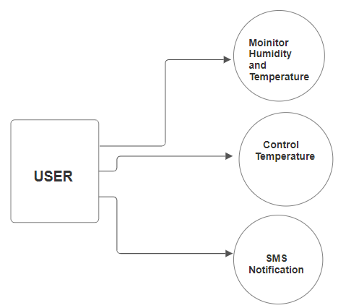
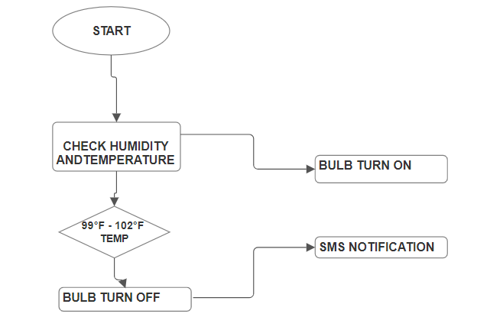
EXISTING MODEL

Slide 9
Proposed IOT Based Solution
To ensure precise control and optimization of humidity and temperature, the proposed approach focuses on developing a model to calculate egg weight loss and make informed decisions for IoT-based incubation.
Humidity levels within the incubation environment play a critical role in determining the rate of moisture loss from the eggs, consequently impacting their weight loss during incubation.
Lower humidity levels can accelerate moisture loss, potentially leading to higher egg weight loss. Conversely, higher humidity levels can slow down the rate of weight loss.
This can reduce the rate of embryo growth properly and not hatching properly , so proper monitor through cloud storage and managing it remotely can reduce this issue. The egg rotator helps to provide temperature equally to each portion of the egg to improve mortality rate of infants.

Slide 10
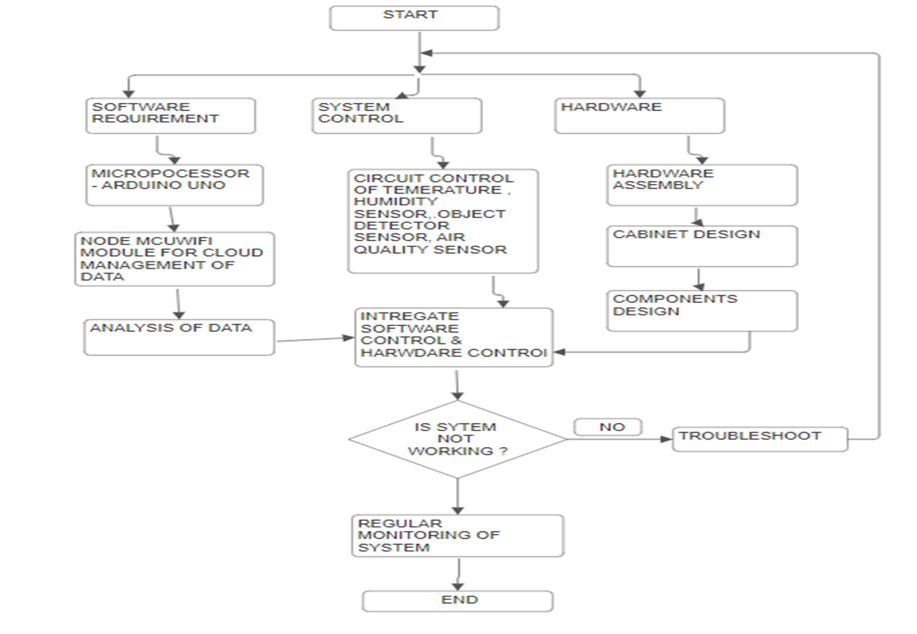
Flow Diagram of the Model

Slide 11
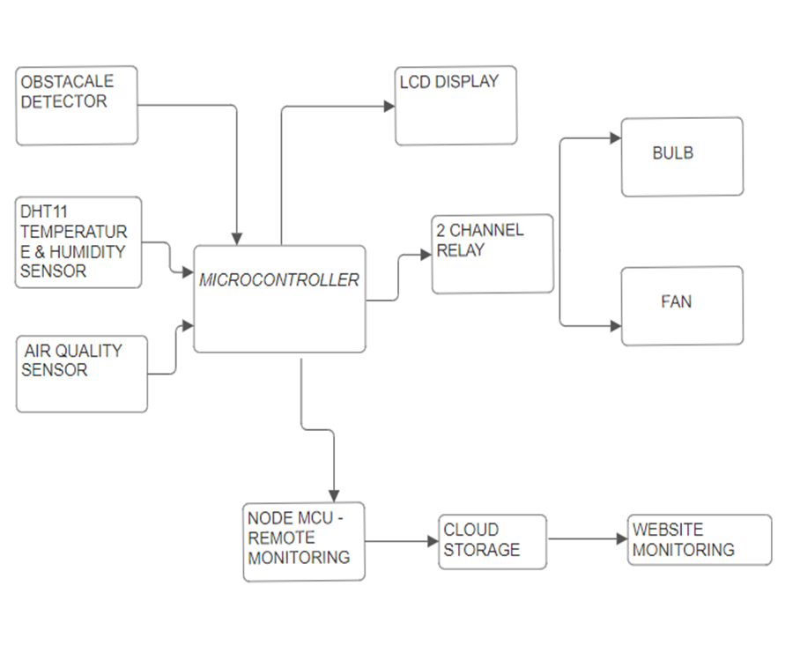
Block Diagram Of The Circuit

Slide 12
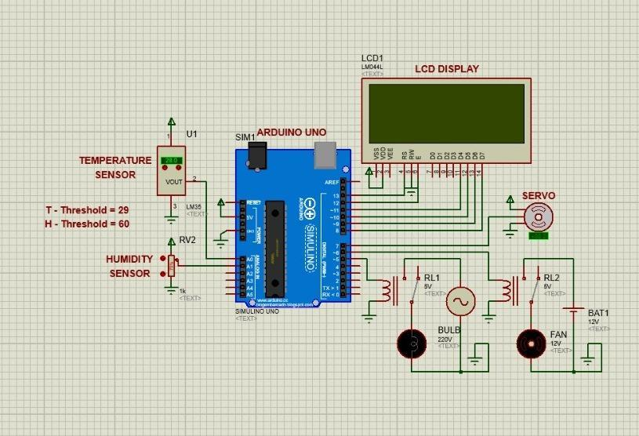
Simulation

Slide 13
Design Parameter
Temperature and Humidity Sensors: The design incorporates high-precision temperature and humidity sensors to accurately monitor and control environmental conditions within the incubator. Calibration, accuracy, and response time are critical parameters considered during sensor selection and integration.
Microcontroller Selection: Our model utilizes a microcontroller with sufficient processing power, memory capacity, and communication interfaces (such as I2C, and SPI) to handle real-time monitoring, data logging, and IoT connectivity. The microcontroller's efficiency and reliability play a crucial role in the overall performance of the incubator system.
Egg Rotator Mechanism: The design of the egg rotator mechanism includes motor specifications (e.g., torque, speed), gear ratios, and rotation intervals optimized to ensure uniform heat distribution around eggs.
Power Supply Design: The power supply unit is designed to deliver stable and clean power to all components of the incubator system. Factors such as input voltage range, output voltage regulation, current capacity, and protection features are considered to ensure reliable operation and protection against voltage fluctuations or power surges.
User Interface Design: The user interface design includes intuitive controls, status indicators, and a graphical display for easy monitoring and interaction with the incubator system. User-friendly features, such as real-time notifications, settings customization, and enhance user experience and operational convenience.

Slide 14
Design Parameter
Capacitor Design: Capacitors in our model are chosen to meet specific requirements for voltage regulation, filtering, and energy storage. Capacitance values, voltage ratings, and ESR (Equivalent Series Resistance) are carefully considered to maintain power stability and reduce noise in the system. Using the formula C = I * t / ΔV: C = (1.5A * 10μs) / 0.1V = 150μF
Inductor Design: The inductor design in our model is optimized for efficient power delivery and minimal heat dissipation. It is selected based on factors such as current rating, inductance value, and core material to ensure stable and reliable operation of the incubator system.
Using the formula L = (V * t) / (ΔI), where V = 12V (hypothetical voltage) , L = (12V * 10μs) / (1.5A) = 80μH
Temperature and Humidity Sensors: The design incorporates high-precision temperature and humidity sensors to accurately monitor and control environmental conditions within the incubator. Calibration, accuracy, and response time are critical parameters considered during sensor selection and integration.
IoT Connectivity: Our model incorporates IoT modules like NodeMCU for seamless connectivity, allowing remote monitoring, control, and data logging via Wi-Fi or other communication protocols. Security protocols, data encryption, and cloud integration are integrated into the design to ensure data privacy and accessibility.

Slide 15
HARDWARE REQUIREMENTS
1.Arduino UNO Microcontroller
2.AIR Quality Sensor – MQ135
3.AC Power Supply
4.Step Down Transformer
5.Bridge Rectifier
6.2 Channel Relay drivers
7.Humidity & Temperature Sensor – DHT11
8.Object Detector Sensor – HC-SR04
9.Led Display & I2C
10.Heating BULB
11.Cooling fan
12.12V Servo Motor

Slide 16


SOFTWARE AND WEBSITE USED
Arduino IDE - EMBEDDED C CODE
Website – Arufrut IO

Slide 17
PROBLEMS CAN BE FACED & SOLVED
1.Inefficient Incubation: Traditional egg incubation methods may result in inconsistent temperature and humidity levels, leading to lower hatch rates and reduced productivity. The proposed system ensures precise control of these parameters, improving overall incubation efficiency.
2.Limited Monitoring Capabilities: Without real-time monitoring, farmers may not be aware of issues such as temperature fluctuations or power outages, which can adversely affect egg hatchability. The IoT-based system provides continuous monitoring and alerts, allowing for timely intervention to prevent losses.
3.Increase Infant Mortality Rates: In regions with limited access to advanced healthcare facilities, newborns may face higher mortality rates due to inadequate monitoring and care. The neonatal baby incubator with real-time monitoring capabilities and egg rotator in equal distribution of temperature can help address this issue by providing critical data to healthcare providers and enabling timely interventions.
4.Resource Constraints: Small-scale farmers or healthcare facilities may lack the resources to invest in expensive incubation or neonatal care equipment. The proposed low-cost solutions offer an affordable alternative, democratizing access to advanced technology and improving outcomes for all stakeholders.
5.Environmental Challenge: Extreme weather conditions or environmental factors can pose challenges to traditional farming or healthcare practices. The system's ability to maintain optimal conditions regardless of external factors mitigates these risks and ensures consistent performance.
6.Data-driven Decision Making: Without access to real-time data and analytics, farmers and healthcare providers may struggle to make informed decisions. The proposed system collects and analyzes data, enabling stakeholders to identify trends, optimize processes, and make data-driven decisions to improve outcomes.
7.Communication Gaps: In remote or rural areas, communication gaps between farmers, healthcare providers, and stakeholders may hinder coordination and response times. The system's remote monitoring capabilities bridge these gaps, facilitating seamless communication and collaboration for better outcomes.

Slide 18
METHODOLOGY
Seamless Connectivity: Connects sensors, actuators, and CPU for real-time monitoring.
Remote Access: Monitor and manage from anywhere via web or mobile apps.
Automation: Automates temperature, humidity, and egg turning for optimal conditions.
Data Analytics: Analyzes data for optimized settings and improved hatch rates.
Cloud Integration: Provides data storage, backup, analytics, and scalability benefits.

Slide 19
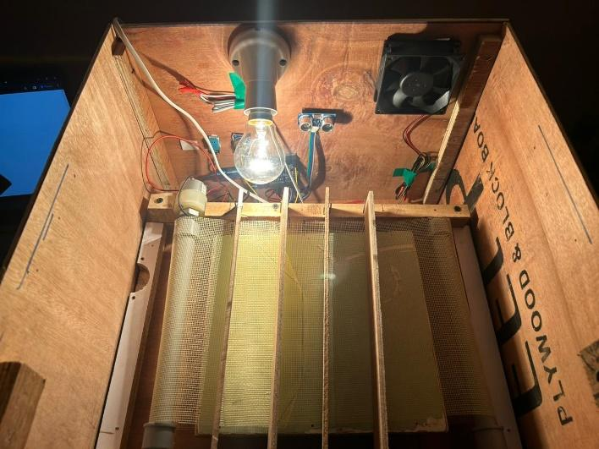
Use of Egg Rotator
The incorporation of an egg turner in our proposed incubator model significantly improves hatchability by ensuring uniform heat distribution, preventing hot spots, and reducing the risk of deformities or mortality. This consistent rotation also enhances chick growth and development post-hatching, promoting proper muscle and bone development. With advanced features like precise temperature control and uniform egg rotation, we aim for an average incubation period of around 21 days for chicken eggs, leading to higher hatch rates and healthier poultry stock compared to traditional incubators.

Slide 20
ADVANTAGES
Enhanced Efficiency: The incorporation of IoT technology allows for real-time monitoring and control of incubation parameters, leading to improved hatch rates and egg development efficiency.
Cost-effectiveness: Utilizing Arduino microcontrollers and NodeMCU for monitoring reduces the cost of implementation compared to traditional incubation systems, making it accessible to a wider range of farmers and healthcare facilities.
Remote Monitoring: The ability to monitor the status of eggs and newborns remotely via IoT technology enables farmers and healthcare professionals to intervene promptly when necessary, reducing the risk of losses and improving overall outcomes.
Optimal Conditions Maintenance: The system ensures optimal conditions such as temperature, humidity, and motion detection, leading to healthier newborns and increased survival rates in both poultry farming and neonatal care.
Data Analysis: The collection of real-time data allows for analysis of trends and patterns, potentially leading to further optimizations through the implementation of machine learning algorithms.
Improvement of Productivity and Survival Rates: By addressing critical concerns in agriculture and healthcare sectors, the project aims to enhance productivity in poultry farming and increase survival rates for newborns, ultimately benefiting the respective industries and communities.

Slide 21
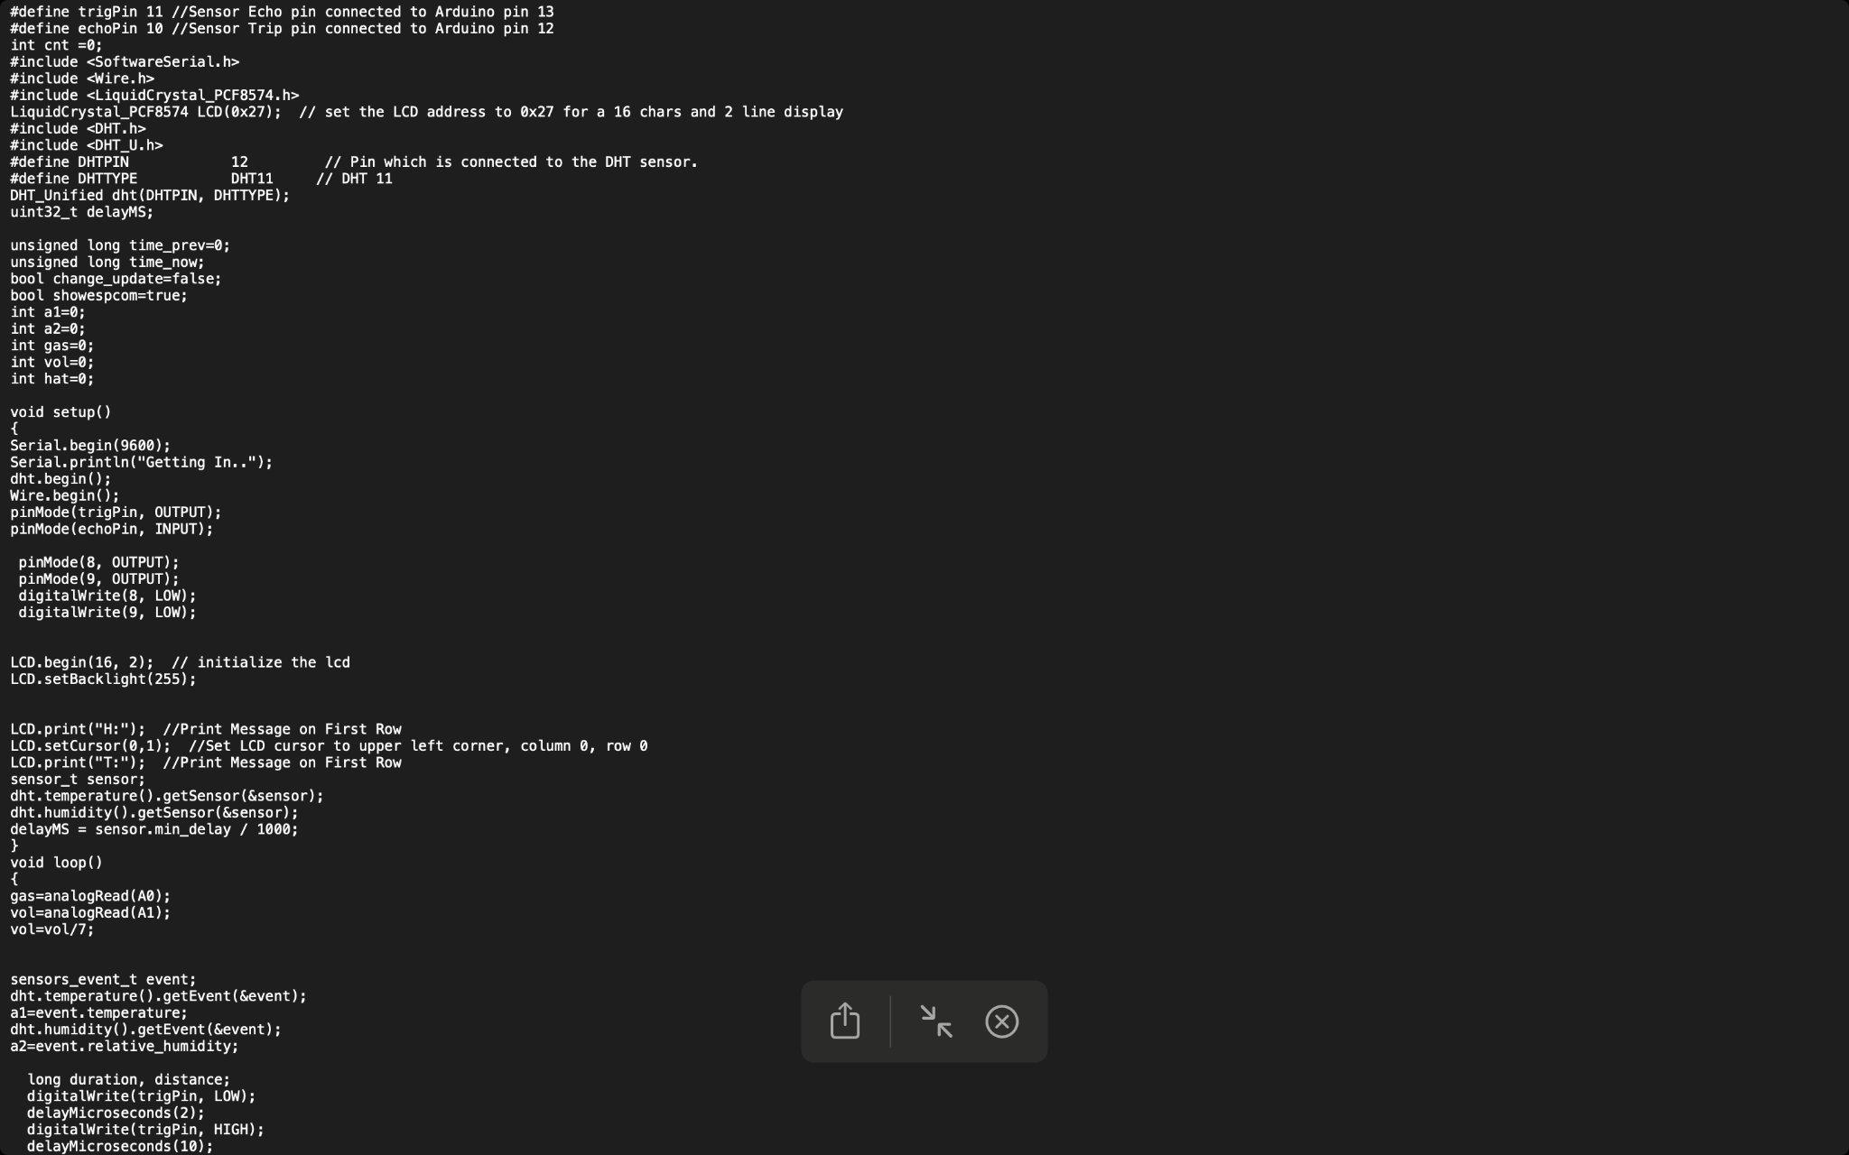

Arduino Code
Wifi Module Code

Slide 22
RESULT
1.An enhanced egg incubator system utilizing Arduino microcontroller and Node MCU for IoT-based live monitoring.
2.The incubator maintains optimal conditions of temperature, humidity, and egg rotation, ensuring superior hatch rates and efficient egg development.
3.Node MCU enables real-time monitoring of egg status, facilitating timely intervention, and indicating hatched eggs.
4.Additionally, a low-cost neonatal baby incubator is proposed, leveraging microcontrollers and IoT technology for real-time monitoring.
5.Analog and digital sensors ensure optimal conditions including temperature, humidity, and motion detection for infant care.
6.Both initiatives aim to address critical concerns in agriculture and healthcare sectors, enhancing productivity and survival rates.
7.The egg incubator has a egg rotator which rotates using a 12V DC motor which provides equal temperature to each and every side for better growth of infants

Slide 23
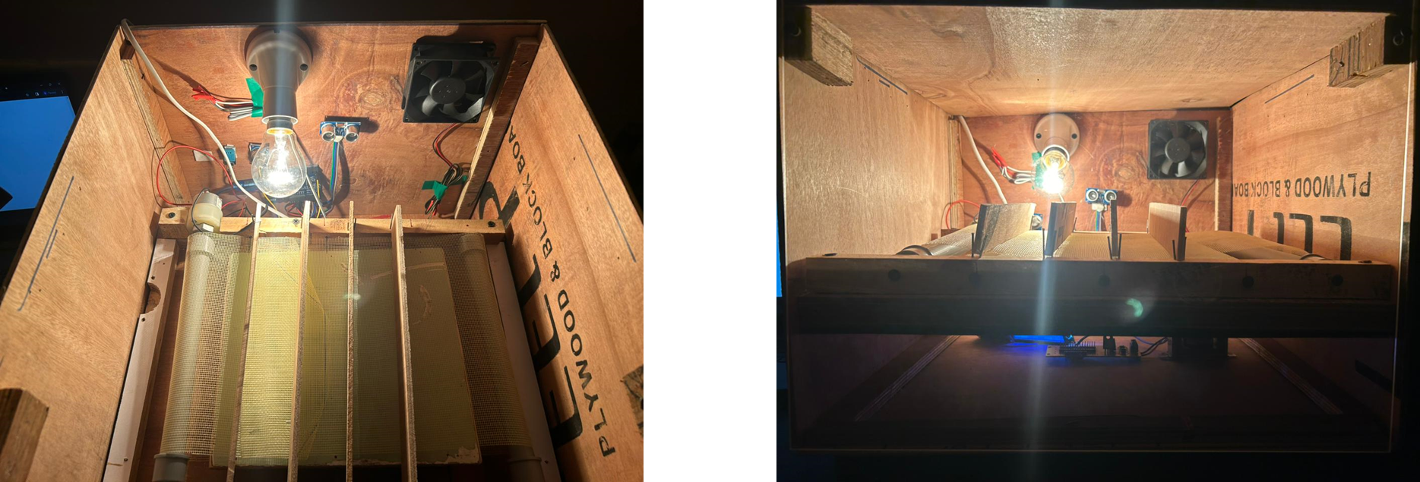
FINAL MODEL AND EGG ROTATOR

Slide 24

Model Video

Slide 25
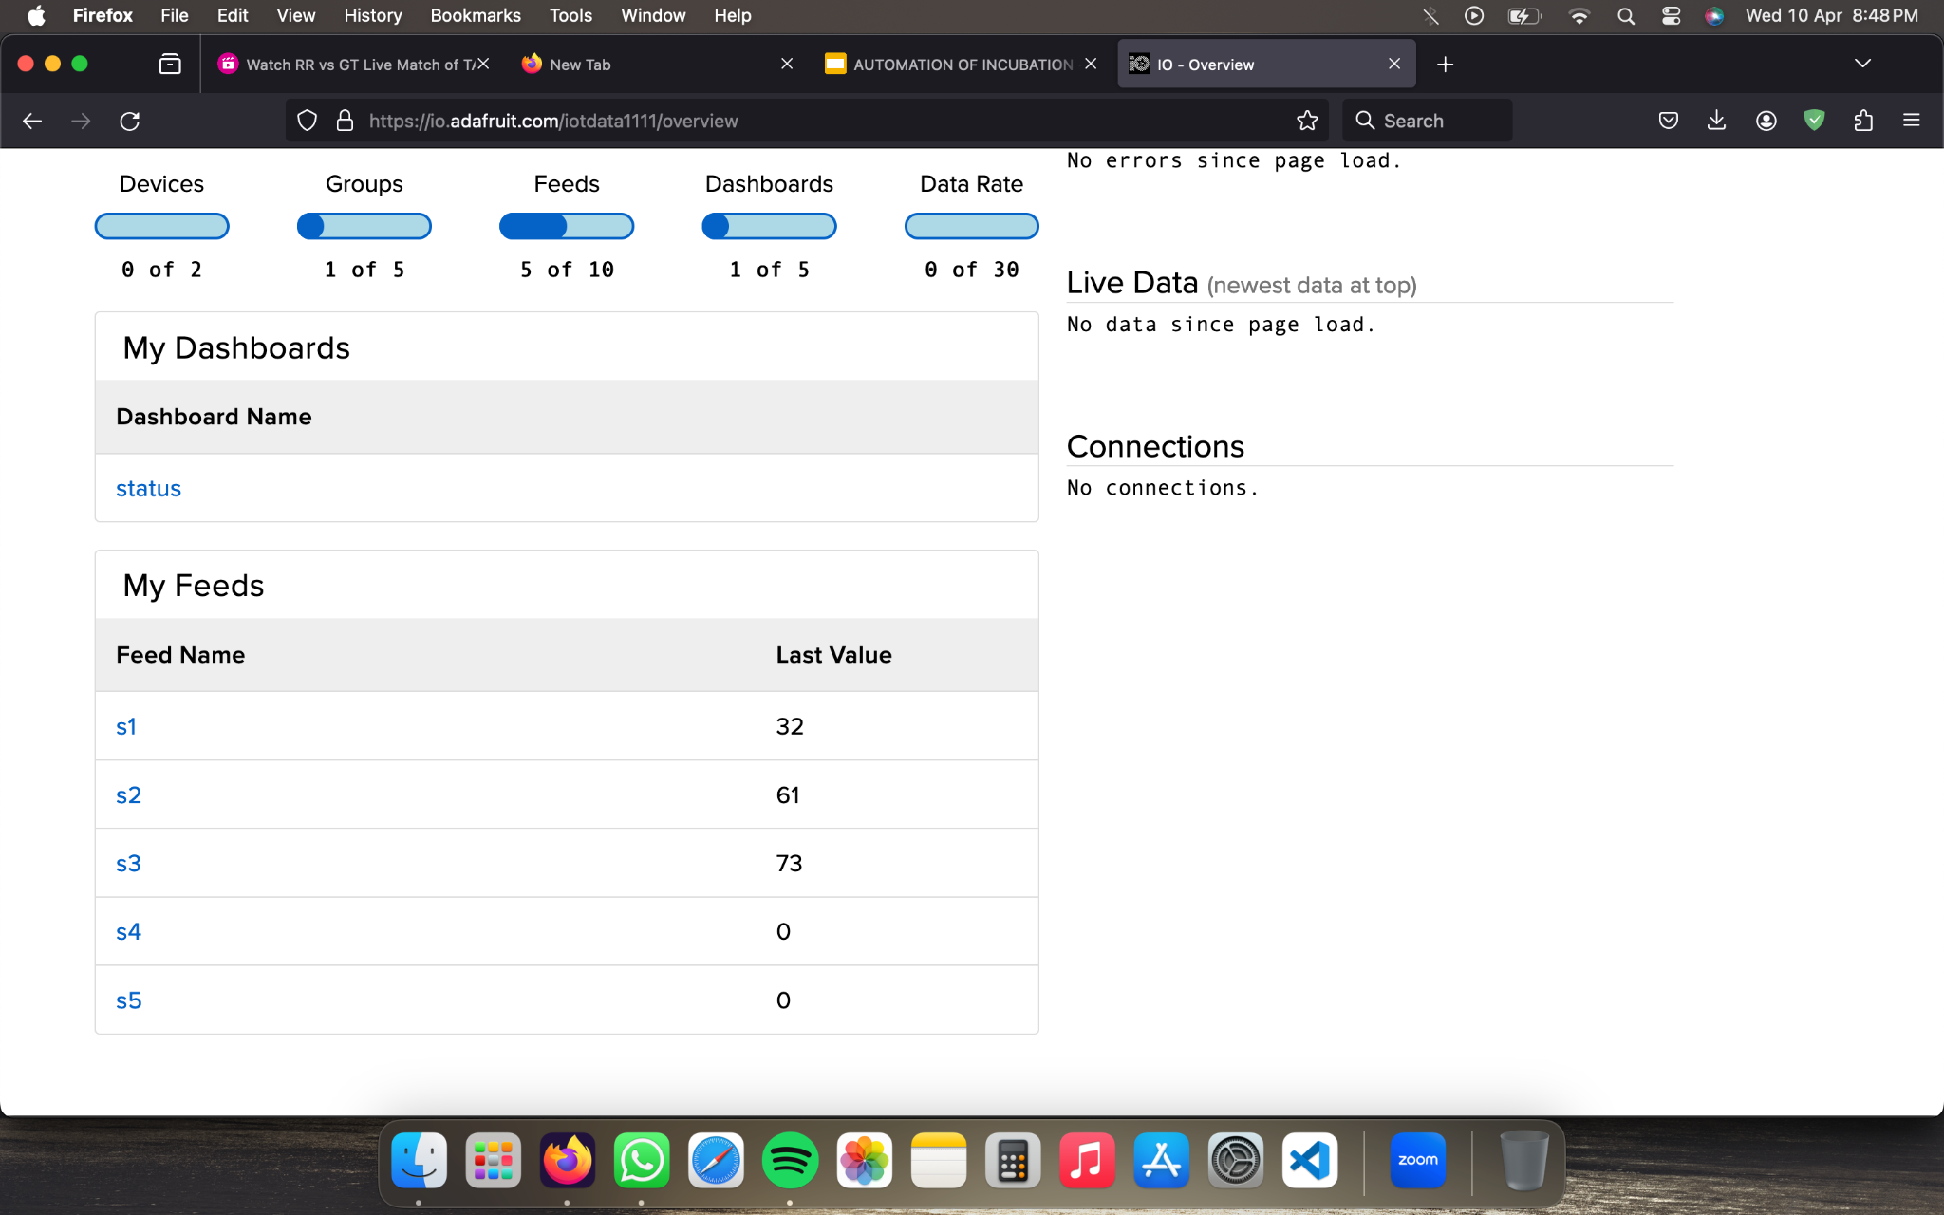
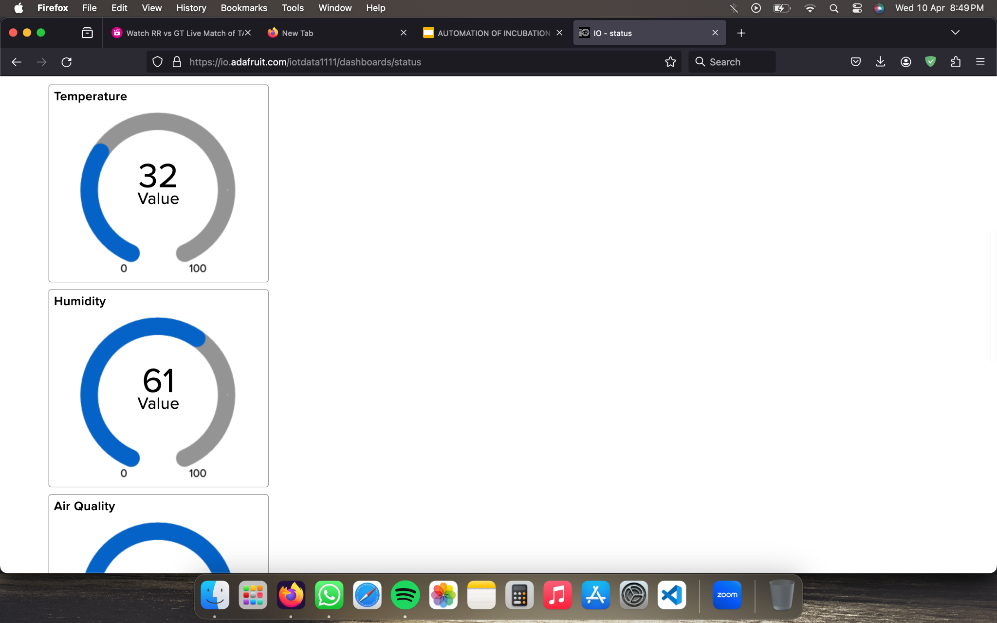

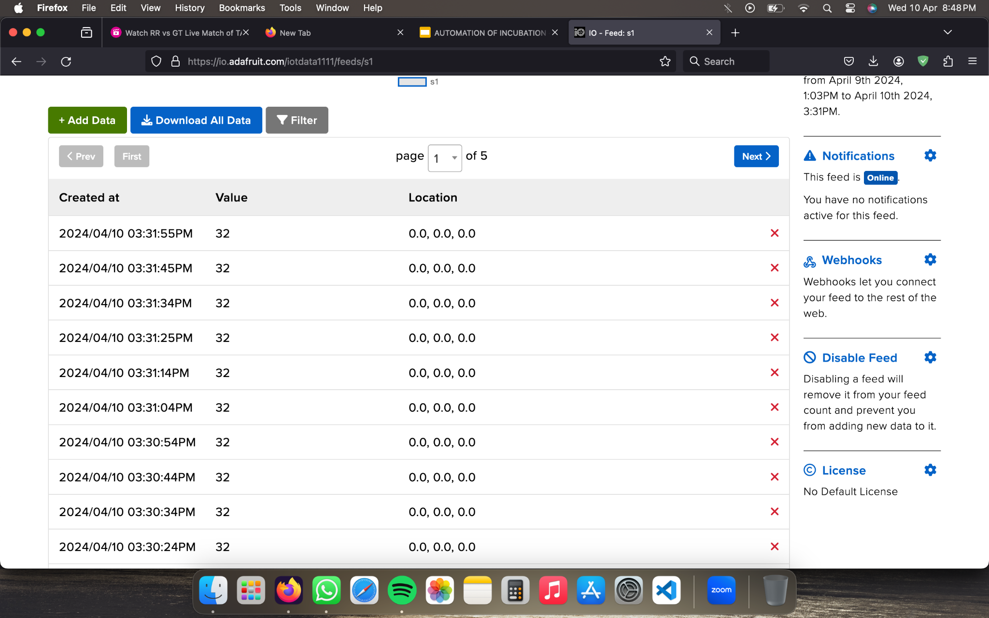

Slide 26
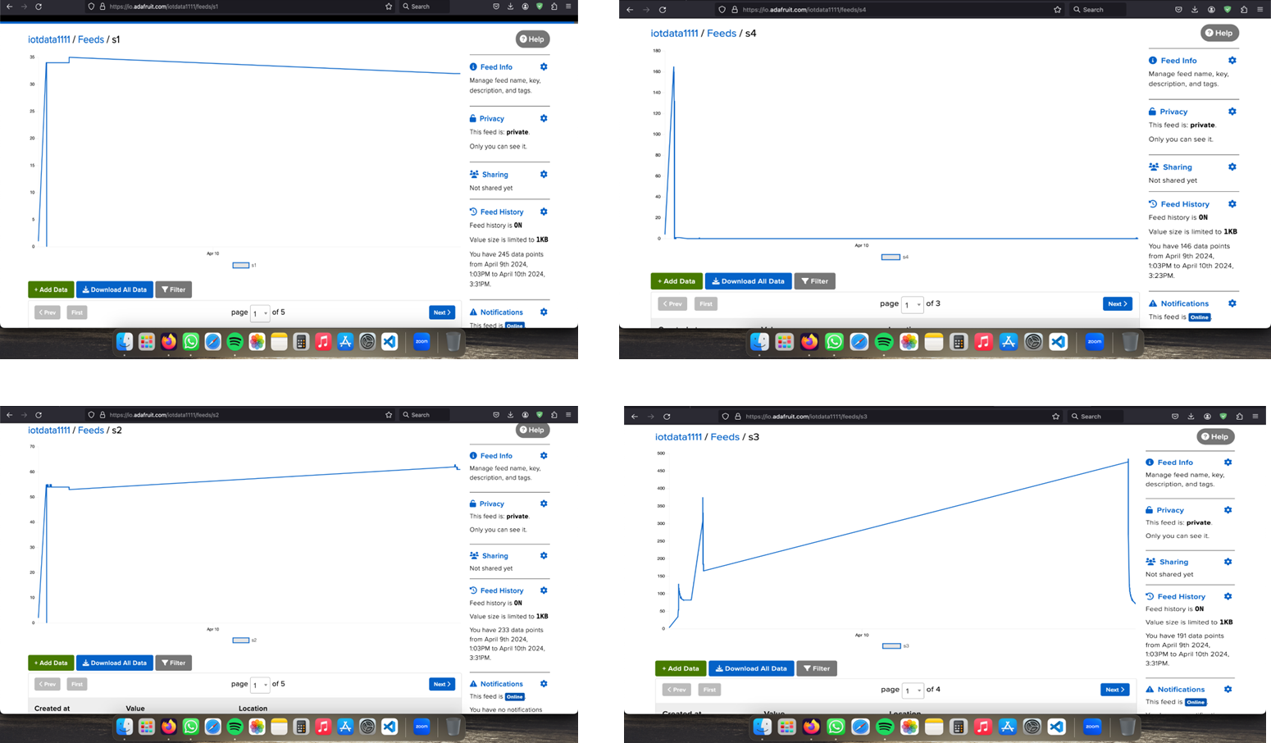

Slide 27
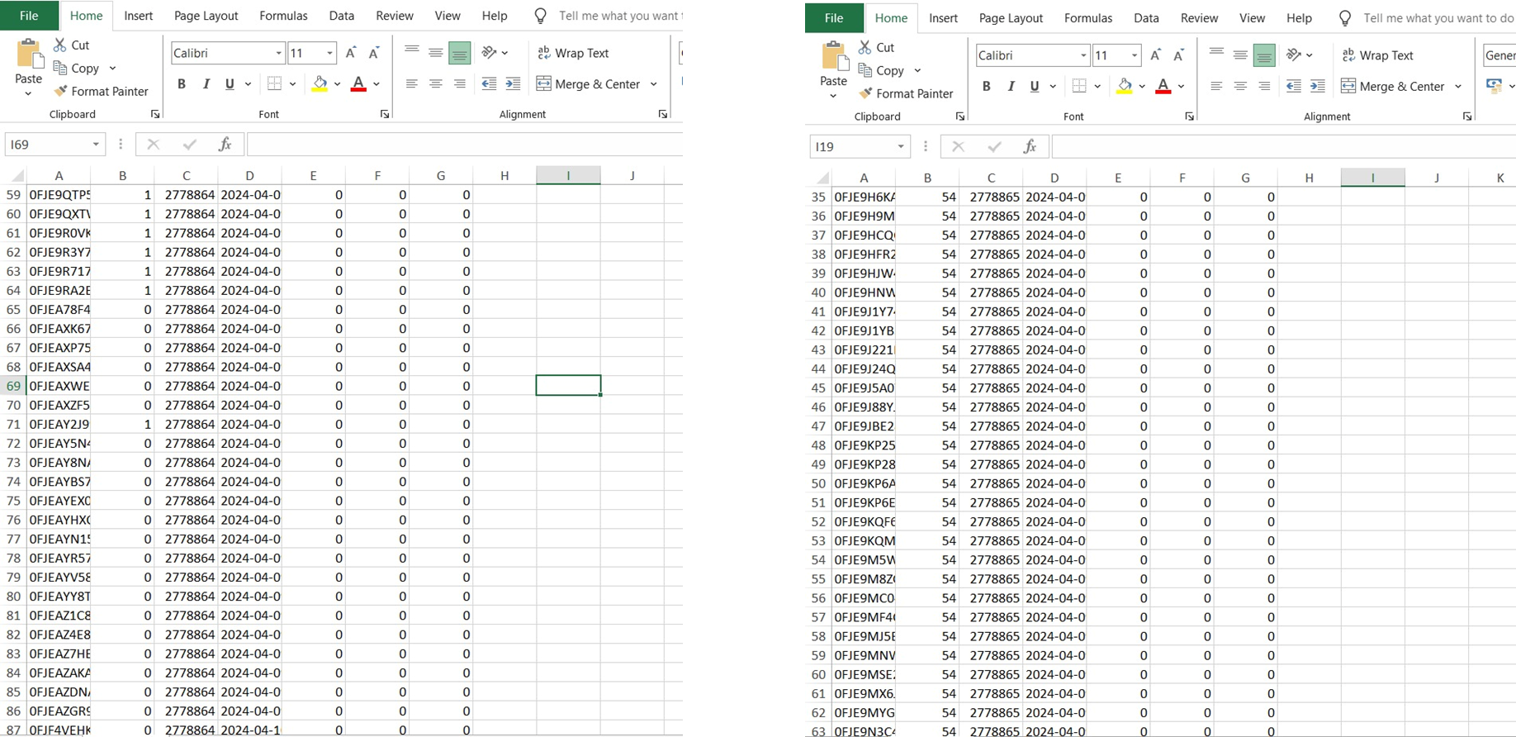
CLOUD DATA OF HATCHING , HUMIDITY , TEMPERATURE & AIR QUALITY

Slide 28
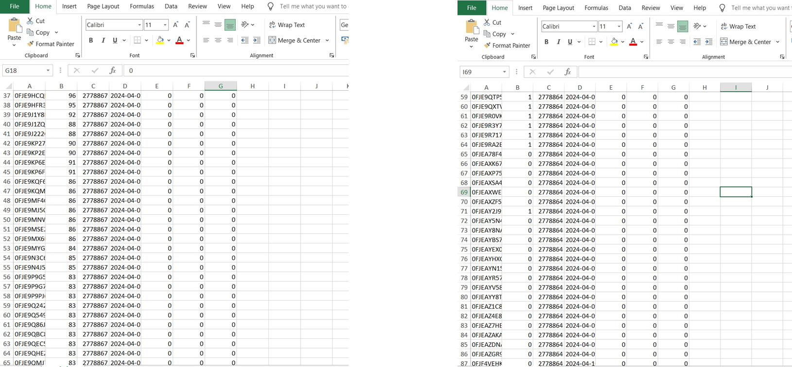

Slide 29
Practical Applications and Real-World Implications
Poultry Farming Optimization: Automated egg incubator system revolutionizes poultry farming by providing precise control over environmental factors like temperature and humidity. This leads to higher hatch rates, healthier chicks, and ultimately, improved productivity and profitability for poultry farmers.
Remote Monitoring and Management: The IoT integration in your incubator allows for remote monitoring and management from anywhere in the world. Farmers can check the status of the incubator, receive alerts for critical events like hatching, and adjust settings as needed without being physically present at the farm.
Data-Driven Decision Making: By providing cloud storage and data analytics, your model enables data-driven decision-making in poultry farming. Farmers can analyze historical incubation data, identify trends, and make informed adjustments to optimize hatch rates and chick health.
Reduced Labor and Costs: Automation reduces the need for manual intervention in the incubation process, saving labor costs and minimizing human errors. This is especially beneficial for large-scale poultry operations where efficiency and cost-effectiveness are paramount.
Improved Chick Health and Mortality Reduction: The automated system ensures consistent and optimal conditions for egg incubation, leading to healthier chicks with lower mortality rates. This contributes to sustainable poultry production and better animal welfare standards.
Environmental Monitoring: Beyond incubation, the system's sensors can be repurposed for environmental monitoring on the farm. For example, air quality sensors can detect harmful gases or pollutants, helping farmers maintain a healthy and safe environment for their poultry.

Slide 30
CONCLUSION
Our proposed model represents a significant advancement in egg incubation and chicken hatching processes. It's designed to optimize every aspect of incubation by closely monitoring environmental parameters like air quality, humidity, and temperature. The integration of cloud technology ensures seamless data management, offering clear visualizations and comprehensive insights into the incubation process and hatching events over time. The standout feature of our system is the egg rotator mechanism, which provides consistent and uniform heat distribution, leading to improved hatch rates and healthier chicks. Additionally, the system's user-friendly interface allows for remote access and real-time monitoring, enabling timely interventions and maximizing convenience and efficiency for users worldwide.

Slide 31
REFERENCE
•T. A. Adegbulugbe, A. O. Atere, and O. G. Fasanmi, “Development of an Automatic Electric Egg Incubator,” Int. J. Sci. Eng. Res., vol. 4, no. 9, pp. 914–918, 2013.
• G. A., “Design, Construction and Performance Evaluation of an Electric Powered Egg Incubator,” Int. J. Res. Eng. Technol., vol. 03, no. 03, pp. 521–526, 2014, doi: 10.15623/ijret.2014.0303097.
•F. Kyeremeh and F. Peprah, “Design and Construction of an Arduino Microcontroller-based EGG Incubator,” Int. J. Comput. Appl., vol. 168, no. 1, pp. 15–23, 2017, doi: 10.5120/ijca2017914261.
• U. A. State, “DEVELOPMENT AND TEMPERATURE CONTROL OF SMART EGG,” vol. 4, no. 2, pp. 13–21, 2016.
•N. Islam, M. Uddin, A. Arfi, S. Alam, and M. Uddin, “Design and Implementation of IoT Based Perspicacious Egg Incubator System,” 2019, pp. 251–255, doi: 10.1109/IEMECONX.2019.8877043.
• W. S. M. Sanjaya et al., “The development of quail eggs smart incubator for hatching system based on microcontroller and Internet of Things (IoT),” 2018 Int. Conf. Inf. Commun. Technol. ICOIACT 2018, vol. 2018-Janua, pp. 407–411, 2018, doi: 10.1109/ICOIACT.2018.8350682.
•L. A. Szolga and A. Bondric, “Smart System for Incubating Eggs,” in 2020 IEEE 26th International Symposium for Design and Technology in Electronic Packaging (SIITME), 2020, pp. 260–264, doi: 10.1109/SIITME50350.2020.9292305.

